Slide 1
Ethiopia Poverty Measurement Training
Day 1: Welfare aggregate construction recap

Slide 2
Theory of Welfare Measurement
There are many ways to think about welfare or well-being, we will use a definition based exclusively on material well-being
Whether or not a household has enough financial resources to meet their basic needs and participate in society

Slide 3
Welfare and Consumption
We will build a measure of welfare based on the level of real (adjusted for price levels) value (at market prices) of per capita consumption.
What in economic theory justifies this as a meaningful measure of well-being that can be compared over time or across households?
How can welfare theory inform how we value things like own production and how we adjust for price differences?

Slide 4
Monetary Poverty
Only looking at goods/services you need money to buy.
If the state provides free basic health care or education for everyone, you don’t need money to access it, and it doesn’t need to be included in our analysis of monetary poverty.
In some rural contexts, you might not need money to have access to land and construct decent basic housing.

Slide 5
Nominal Consumption Aggregate
In general, include all goods and services consumed by the household
Exclude things that aren’t consumed by members of the household in the reference period
Use consumption instead of expenditure if you can, or make sure expenditure is a reasonable proxy
Use market value or as close as you can get
Exclude atypical (lumpy) consumption/expenditure
What the household spent over the recall period is very different from what they usually spend

Slide 6
Exclusions: not consumption for this household this year
Transfers to other households
These funds will be included when the household receiving them uses them to consume
Donations to religious or charitable organizations
Although part of religious donations may be considered as payment for services, they are better considered as transfers or contributions to public goods
Taxes and levies
Investments, savings, loan repayments (reflect past or future consumption)

Slide 7
Consumption vs Expenditure
Some surveys have both quantity of food consumed, and quantity of food purchased
would use quantity of food consumed
What we want to measure is consumption (how much rice is eaten), what we usually mostly have is expenditure (how much rice is purchased).
data on consumption of food from own production or gifts is the only thing usually captured on the questionnaire as consumption
Is it reasonable to assume that, over the given recall period, expenditure ≈ consumption?
depends on type of item (perishable, consumable or not) and recall period
if recall period is much too short, may be better not to include item at all

Slide 8
Valuation
Based on the consumer theory model, goods and services should be valued at market prices if possible: the prices the household actually faces when acquiring them
Easy when the actual purchase cost is given
More difficult when goods and services are provided to the household and there is no resale market / opportunity cost of consuming
hard to know how to value and quantify consumed does not reflect the household’s optimizing behavior
examples: free school lunches, public services of varying quality, food rations, food or housing provided to refugees/IDPs
exclude altogether or use best estimate: average value of similar things similar households choose to purchase

Slide 9
Atypical/Lumpy Expenditures
Expenditure during the recall period (even if 1 year) is NOT what a household usually spends
Purchases of durable goods, house (we explicitly include this via annual use value instead)
Life event expenses (weddings, funerals, baby naming)
Large medical expenses
Why not include?
Often represents deliberate unsmoothing of consumption by households (theoretically, this consumption maybe should be allocated over entire lifetime of household)
This deliberate unsmoothing loses the link to household’s expectation of permanent income
Why might you want to include?
Household that have the money to pay for these things are better off than those who don’t
There is some displacement: households probably spend less on other things in years where they make these big purchases
The more unexpected, the more displacement (funerals, medical expenses)

Slide 10

Avoid Double Counting
Some items may be included twice on the questionnaire in different ways / with different recall period
transport for school and health care in those sections, all transport in nonfood expenditures
mobile phone credit in individual ITC section, also nonfood expenditures
small durable goods in durable goods section and also nonfood expenditures
Make sure to avoid double counting, pick only one source
probably the more detailed source / the one with the longer recall period is better

Slide 11
The Nominal Consumption Aggregate
Food consumption
Regular food consumption
Food away from home
Nonfood consumption
Durable goods
Housing
Nonfood nondurable goods
Education and health expenditure
Alcohol, narcotics and tobacco

Slide 12
Food Consumption
All food consumed during the reference period should be included:
Food purchased in the marketplace, including meals purchased away from home for consumption at home or away from home.
Food produced by the household.
Food received in-kind, both supplies and prepared meals, as transfer from other households, charities or the government, or received as payment or benefit.

Slide 13






Classification / Grouping of Food
Ingredients (rice, oil, salt) or prepared meals / snacks (a plate of rice and sauce)?
How obtained? Purchased, own production, received for free [bought at subsidized prices]
Consumed at home or away from home?

Slide 14




Food Away from Home
Lots of recent work on how important this is
Term “FAFH” can be used somewhat ambiguously to mean food prepared outside of the home, or food consumed outside of the home, or both or either.
All of these should be included in the aggregate.
Food Prepared Outside the Home
Food Consumed Outside the Home
Lunches taken to
work or school
Take-Away
Meals in restaurants, canteens, cafeterias
Street food

Slide 15
Non-food Consumption
Exclude
Transfers to other households
Donations to religious or charitable organizations
Investments, savings, loan repayments
Taxes and levies (income tax)
Life event expenses (marriage, funeral etc)
Value of public services
Inputs for household businesses
Purchases of durable goods
Major household repairs or upgrades to dwelling
Include
Most nonfood, nondurable goods and services
Insurance
Leisure expenditures / holidays
Salaries of household staff
Minor repairs and maintenance of dwelling

Slide 16
Considerations
Include expenses scattered throughout the questionnaire:
Alcohol, tobacco, narcotics are often collected in the food section
generally processed with food
Water, electricity, gas, other fuels, home maintenance/repairs. These are sometimes included here, sometimes with housing, make sure to include once and only once
Some semi-durable goods may be included in non-food expenditure. If they are in the durable good section, include use value from there only. If they are not, make judgement call based on how lumpy the item is
Avoid double counting
Pay attention to health and education expenses (particularly transport), ITC expenses
Annualize
Recall periods may vary

Slide 17

Durable goods
Durable goods “deliver useful services to a consumer through repeated use over an extended period of time.”
Lumpy/valuable enough to make practical to ask respondent about current stock and value
In a way that it wouldn’t be to ask about pairs of shoes or cooking pots.
Physical goods for which the use year after year can be realistically modeled using depreciation

Slide 18
Items to Exclude
Make sure to only include consumer durable goods, not farm implements or productive assets for a household business
Sewing machines are often in included in this list, in many context they are productive assets for a business, not a consumer good for a hobby
Goods that are used as a store of wealth (silver and gold) rather than for use should also be excluded
Some durable goods maybe also be included in the non-food expenditure section, make sure not to double count
For most things, it’s better to take use value than expenditure if you have both
Some questionnaires include houses and land in this list
Value of housing actually used is included elsewhere
Farmland is productive asset
Other dwellings / land might be a source of savings or income but are not consumption

Slide 19
Consumption Flow
How much of the value / purchase price of the durable good is “used up” for the year that is the reference period for the survey?
Three methods:
Acquisition approach (wrong)
Rental equivalence approach (practically impossible)
User cost approach (recommended)
If you are interested, see M&V 4.4 for discussion of 1 & 2. M&V and most practitioners agree that 3 is to be used.

Slide 20
Validity of Assumptions
Poor households in low-income countries may sell assets to raise cash, but in many contexts, it is not a very common practice (pawning of assets may be common in some contexts)
But: a rich market for second-hand consumer durables does exist which would help households be able to estimate the value of their goods
Poor households in many contexts don’t actually have the opportunity to save their money at the official interest rate
But: there is still a benefit of having money now as opposed to later
Bottom line:
we taking use value as a fraction of the current value of the item, usually between 10 and 40%
the utility/value a household gets from the durable good declines over time as the good ages / wears out

Slide 21
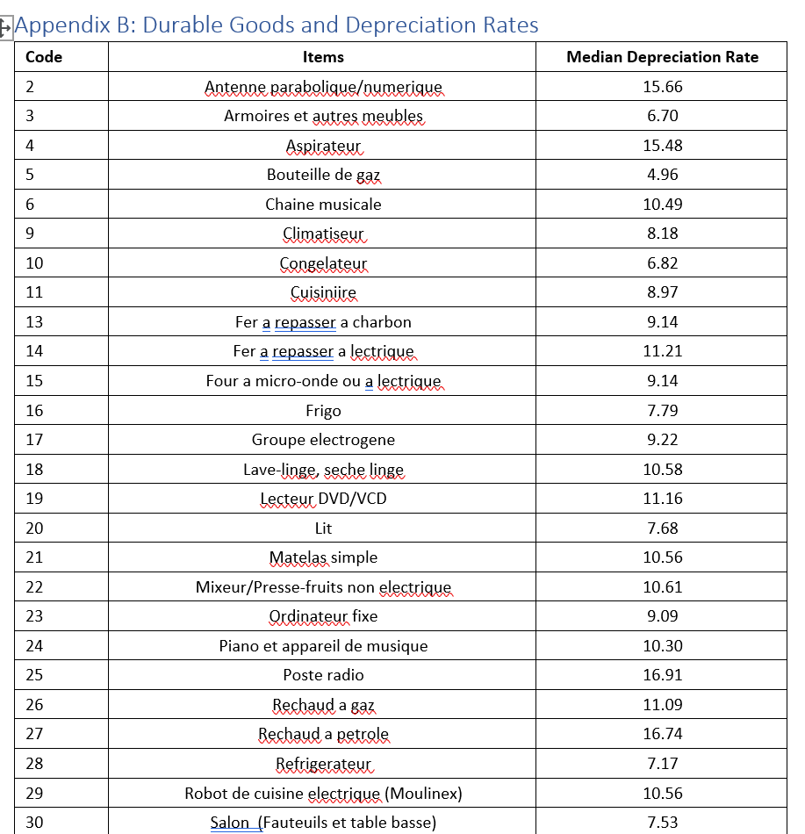
Reporting Depreciation Rates
Notes:
Example from Cameroon

Slide 22

Multiple Items
Households can own multiple items of the same kind
Questionnaires often only collect information on one, sometimes the newest
Some questionnaires collect information on 2 or 3
If households own more items than we have information on, usually just assume all of them have the same value
If newest is specifically asked about, could assume others have only a fraction of the value

Slide 23

Education Expenditures
There are theoretical reasons not to include:
Specific to a particular point in the household’s life cycle, theoretically should be smoothed across life cycle of household members – impossible in practice
Could be considered investment / savings rather than consumption
In practice, education is always included

Slide 24
Education Expenditures (cont.)
Expenditure on education is usually collected at individual level
Check logic of questionnaire and skip patterns to make sure a value is included for all children [likely] attending school
Include all components if recorded: tuition / fees, payments for uniforms, schoolbooks, school lunches, mandatory contributions, informal fees etc
Context dependent which of these can realistically be zero
Take note of recall period, annualize if needed
Definition of recall period is one of the hardest parts of education questionnaire design
Different annualizations may be needed if recall period is “current school year to date”
Identification of outliers may need to take into account level (primary vs. secondary) and type of school (private vs. public)

Slide 25
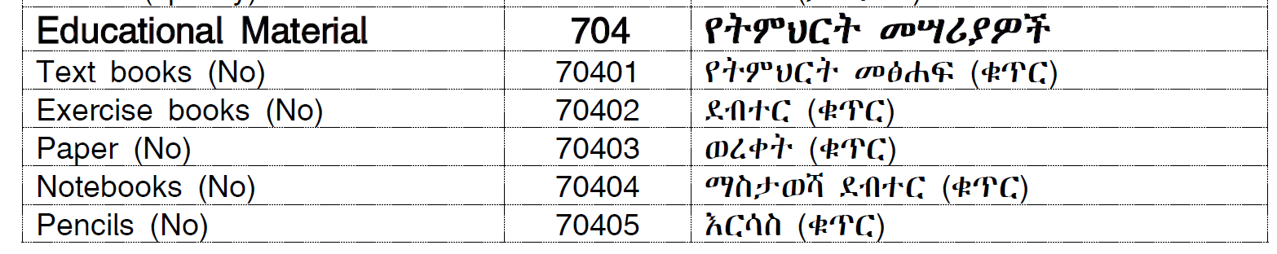
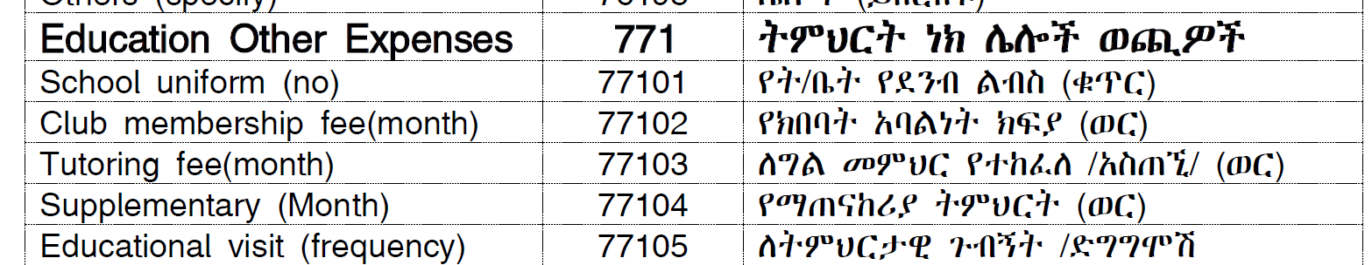
NIHS 2024
Across from section 704XX to 772XXX

Slide 26

Health Expenditures
Deaton and Zaidi recommended against the inclusion of most health expenditures
Most practitioners have included at least some health expenditures
Sound theoretical arguments have been made as to why they should be included
Recommendation has changed: (most) health expenditures should be included
If possible, include informal payments to health care providers
For countries with insurance
include insurance premiums
include out-of-pocket expenditures for health care

Slide 27
NIHS 2024
Drugs (dose code 43) 104
Traditional/Cultural Medicines (Dose) 105
Preventives and Related Tools 106
Medical expenses on Governmental health Institutions 501
Medical expenses on private health Institutions 502
Other medical expenses ( Service) 503

Slide 28
Link to Welfare Theory
Trade off between including health expenditures for comprehensiveness and excluding health expenditures because they are linked to a loss of welfare
Including them is consistent with welfare theory as outlined in topic 0
“A monetary measure of wellbeing is inevitably unable to account for some aspects of welfare, such as the state of one’s health.”
Best to accept that the NCA never reflects health status
Not measuring how many problems you have, just the financial resources available to solve them

Slide 29
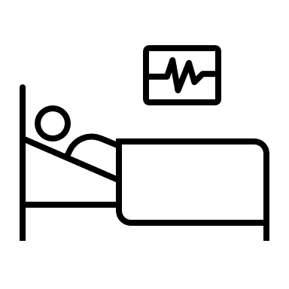
Atypical Expenditures
Health care expenditures do tend to be lumpy: large and infrequent
Recall period for even minor illnesses can be too short: often one month
With too short a recall period, you don’t even have a reasonable estimate of what the household spent for that year
Some countries cheat and annualize by a lower factor
For hospitalization, even the maximum recall period may not be enough to reflect “typical” consumption
This is one compelling reason to exclude spending on major health problems (proxied by hospitalization)

Slide 30
Valuing Housing
Housing is a major component of household’s wellbeing
Market tenants:
rent dwelling at market rates
those who purchased a dwelling in an area with deep market for buying/selling dwellings
Non-market tenants:
those who live in a dwelling they constructed / inherited or bought in a shallow market
those whose dwelling is provided for free/at a subsidized rate by the state / their employer / friends or family.

Slide 31

Market Tenants
For renters, use actual rent paid in almost all cases
For those who purchased their dwelling, and a strong market exists
could consider as a durable good
could use mortgage payment
however, housing tends to appreciate so dwelling functions both as consumer durable good and as investment

Slide 32
Non-Market Tenants
For owner-occupiers: if a rental market exists, the opportunity cost of living in a dwelling you own is the forgone income from not renting it out. Can either:
ask respondent to estimate this directly, or
use a regression to estimate based on characteristics and actual rent for other dwellings in the area
In rural areas of many low-income countries:
no rental market exists
still need to account for the time and materials households spent to construct and maintain their dwelling
Dwellings provided by the state / employer / friends or family
may be considered as income/transfer
actual utility they provide to the household is hard to quantify

Slide 33
Respondent-Estimated Rental Value
Ask the respondent “How much would you have to pay to rent a house / apartment like yours?”
Rental markets may not be present in all areas, particularly in rural areas, making this question very difficult to answer meaningfully
Even if there is a rental market, studies show that owners tend to over-estimate the rental value of their properties

Slide 34
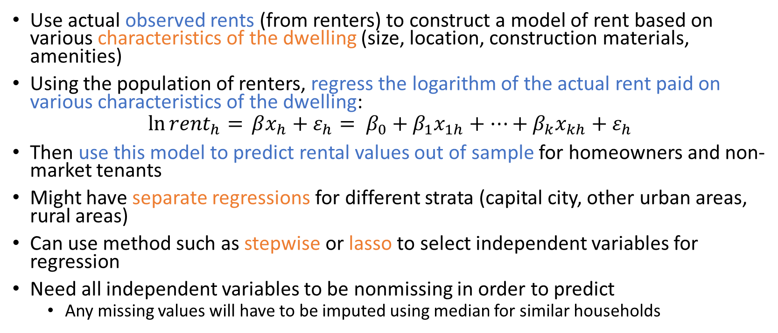
Hedonic Regression
Use actual observed rents (from renters) to construct a model of rent based on various characteristics of the dwelling (size, location, construction materials, amenities)
Using the population of renters, regress the logarithm of the actual rent paid on various characteristics of the dwelling:
$$\ln{{rent}_{h}= }βx_{h}+ε_{h}= {β_{0}+β}_{1}x_{1h}+⋯+β_{k}x_{kh}+ε_{h}$$
Then use this model to predict rental values out of sample for homeowners and non-market tenants
Might have separate regressions for different strata (capital city, other urban areas, rural areas)
Can use method such as stepwise or lasso to select independent variables for regression
Need all independent variables to be nonmissing in order to predict
Any missing values will have to be imputed using median for similar households

Slide 35


Hedonic Regression – modification
In many countries, renters are highly concentrated in urban markets and a model developed based mainly on modern apartments in urban areas may do very poorly predicting the value of traditional houses in rural areas
Can incorporate respondent-estimated rental values into the regression and then used the predicted value from this regression as the rental-equivalent
Assumes respondent-estimated rental values have some information to contribute but provides more consistent relationship between characteristics and value
Should include a binary variable for whether the observation is actual rent or respondent-estimate. If this variable is significant, consider using predictions for all households (including market tenants) for consistency

Slide 36
Exclude Housing Altogether?
Some east African countries have excluded housing altogether in rural areas due to difficulty in constructing a reasonable use value
Very thin to non-existent rental markets in rural areas
Too hard to quantify cost / opportunity cost of living in your own home
Housing may not be something you need money for in rural parts of these countries
Requires separate poverty lines for urban and rural areas
Timor Leste considering excluding housing altogether due to very thin rental markets even in urban areas
Tajikistan excluded housing altogether due to low rates of renting (most households still live in dwellings allocated by the communist state)

Slide 37
Next step
Adjust the nominal consumption aggregate with deflators
Temporal
Spatial
Final consumption aggregate
Combine all the consumption
Adjusting for Household Size and Composition

Slide 38
Deflators
Need to adjust nominal consumption to reflect the actual prices paid by households
Prices can vary over time due to
general inflation
seasonal variation
only a concern when data collection takes place over a longer period (>2 months?)
Prices can across space
often higher in urban areas

Slide 39
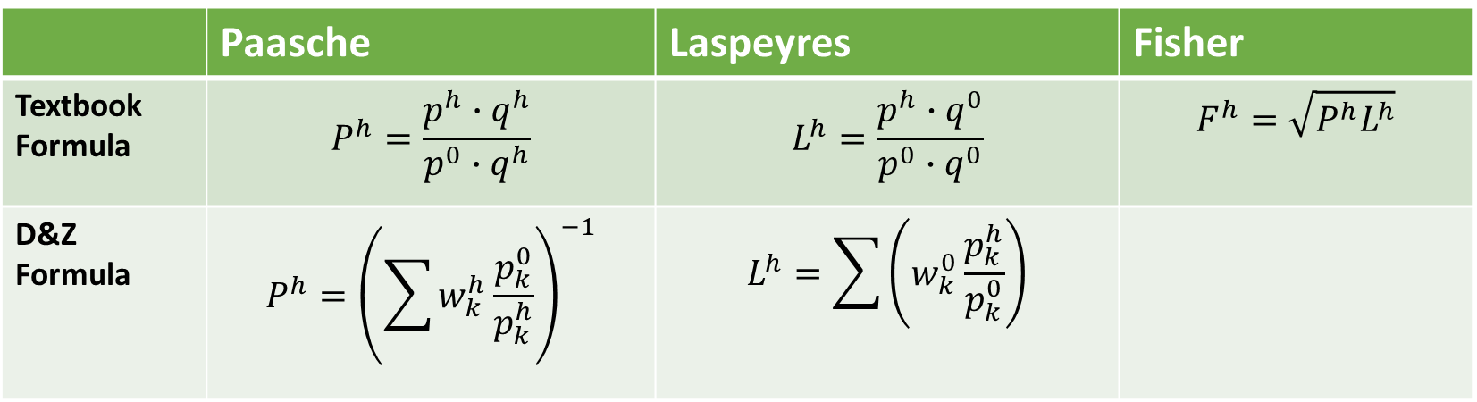
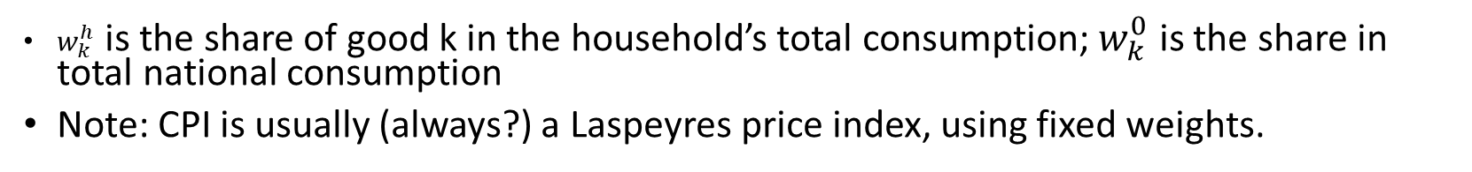
Various Price Indices
 | Paasche | Laspeyres | Fisher
Textbook Formula | $$P^{h}=\frac{p^{h}∙q^{h}}{p^{0}∙q^{h}}$$ | $$L^{h}=\frac{p^{h}∙q^{0}}{p^{0}∙q^{0}}$$ | $$F^{h}=\sqrt{P^{h}L^{h}}$$
D&Z Formula | $$P^{h}={\left(\sum{w_{k}^{h}\frac{p_{k}^{0}}{p_{k}^{h}}}\right)}^{−1}$$ | $$L^{h}=\sum{\left(w_{k}^{0}\frac{p_{k}^{h}}{p_{k}^{0}}\right)}$$
$w_{k}^{h}$ is the share of good k in the household’s total consumption; $w_{k}^{0}$ is the share in total national consumption
Note: CPI is usually (always?) a Laspeyres price index, using fixed weights.

Slide 40
Price Sources
Source | Pros | Cons
Unit values (from observed hh purchases) | Collected in exactly the areas as the households in the survey Classification of foods aligns perfectly | Better-off households may consume higher quality versions of items Within each classification, households will tend to consume more of what is locally relatively cheaper Usually only available for food
Price survey | Collected in exactly the areas of the households in the survey Classification of items can align perfectly Precise quality definitions can be applied Covers food and nonfood | Rarely implemented, additional cost Needs to be done carefully, otherwise will just introduce noise
Raw CPI data | Data on large number of items Should have consistent quality definitions Available at no extra cost Covers food and nonfood | Often only collected in urban areas May not have access to raw data Coding of items may be different from survey

Slide 41
Other Decisions
Use separate temporal and spatial price deflators, or create one joint price index?
I recommend using a joint one UNLESS you want to use the CPI for temporal deflation
If using separate ones, which one to apply first?
M&V recommend applying temporal first
Use separate deflators for separate components of the consumption aggregate (food vs. non-food, by top-level COICOP)?
M&V recommend against this: can distort share of food in total consumption
Use lower level of aggregation for budget shares than for prices?
Budget shares can be down to household level. Prices can be down to cluster-level.

Slide 42
Final consumption aggregate
We have consumption of each item, food and nonfood, including use value of durable goods and housing rental value
Very helpful to maintain this as a final dataset that can be used for different types of analysis in the future
Can add COICOP coding (1 to 3 digits) to this dataset
Can also include source of consumption: purchase, own production, gift, use value etc.
In general, these are nominal, annual values

Slide 43
Aggregating and Final Checks
Sum up consumption of all items over the household
Drop households for which the NCA cannot be constructed
households missing entire sections of the questionnaire
households deemed to have too many missing values / imputations otherwise
household with extreme share of food in total consumption
Reweight to adjust for dropped households
rescale at PSU level so total weight for PSU remains the same
Apply spatial and / or temporal deflators
Adjust for household size and composition
Look at overall distribution and check outliers

Slide 44

Final touch - Household vs. Individual
Welfare, living standards, poverty are individual level attributes, but data is almost always collected at the household level
There is a lot of interesting research on intrahousehold allocation of resources, but these have not been integrated into routine poverty monitoring
Household members are just assigned a share of household resources

Slide 45
Adjusting for Household Size and Composition
How do we compare the welfare status of households with the same NCA, but different household sizes / compositions?
Different persons have different needs: the amount of food consumed by a child is generally less than a working age adults
There are economies of scale: a household of 4 people generally doesn’t need twice as much house as a household of 2 people
Construct a measure of the needs of the household based on its size and composition, usually measured in number of (male) adult equivalents
a household composed of one adult male would be assigned a value of one

Slide 46

Per Capita
Simply use household size
Very simple, used for the dollar-a-day international poverty lines
Assumes no economies of scale, no different needs for different types of people
Might actually be as good as other measures in some contexts

Slide 47

Calorie-Based Equivalence Scales (2/2)
The approach most widely used in practice is based on nutritional (calorie) requirements for various categories of individuals by sex and age
$${ES}_{FAO}= \sum_{i}{\sum_{j}{N_{ij}\frac{E_{ij}}{E_{0}}}}$$
Where for each age group i and sex j, $N_{ij}$ is the number of individuals in the household and $E_{ij}$ is the energy requirement. $E_{0}$ is the energy requirement of an adult male.
Sometimes know as FAO scale, although the FAO itself does not use this scale to adjust household income/consumption

Slide 48
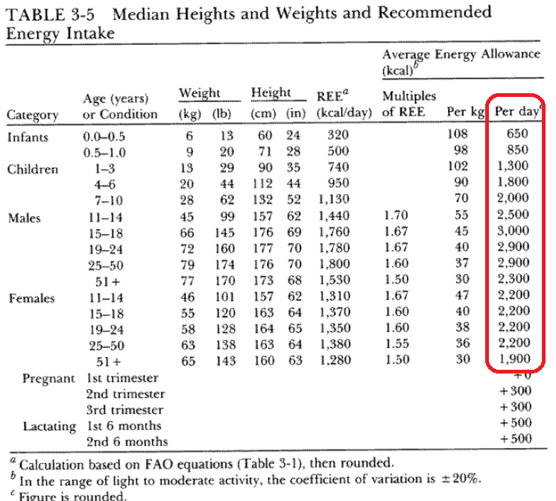
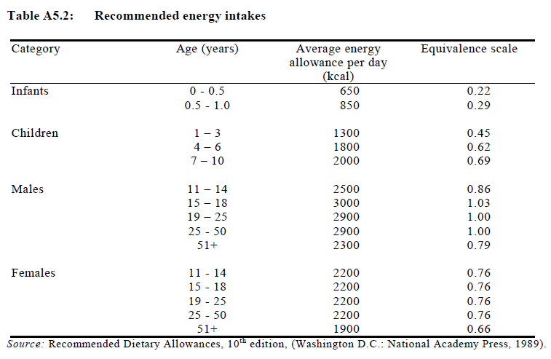
Calorie-Based Equivalence Scales (1/2)

Slide 49
Choice of Equivalence Scale
Calorie-based equivalence scales
this is the probably the best way to adjust food consumption for household size and composition
aligns with the method most often used to construct the food poverty line – the amount needed to buy enough calories for one adult male at prevailing local prices and dietary practices
gives very concrete measure of extreme poverty: those whose total consumption is not sufficient to purchase enough calories for the household
Per capita
very simple and probably does a reasonable job balancing food and non-food needs in lower-income country contexts
Equivalence scales with economy of scale
more appropriate in middle and high-income contexts in which things like housing with large economies of scale are significant share of household budget

Slide 50
Link to Poverty Line Setting
The calorie target you use to set your food poverty line depends on the measure of household size / equivalency you are using
If your welfare measure is per adult male equivalent, you need a calorie target for an adult male
If your welfare measure is per capita, you need an average calorie value for the population in the country

Slide 51
Final step
Construct Poverty line

Slide 52
Updating the Old Line (1/2)
If your surveys are highly comparable, in terms of questionnaire design and welfare aggregate construction, the default option is to use the old poverty line and update it for inflation
Can use official CPI, need to know base of temporal deflation for both surveys, and use inflation between those two base periods
Use headline CPI to inflate total poverty line (not food and nonfood components separately)

Slide 53
Updating the Old Line (2/2)
CPI may
overestimate increase in the true-cost-of-living as it is a Laspeyres index
reflect consumption patterns of the country as a whole which can be different from that of households close to the poverty line
be based on urban prices only, and long term inflation trends in rural areas may be different
be politically motivated (artificially low to avoid COLA adjustments for civil servants)
So can also use alternative indices constructed from the survey data
use budget shares from hh survey, or just a reference population close to the poverty line, and apply to price changes from the CPI at say first digit of COICOP level
cost food basket from previous survey at new national prices

Slide 54
Constructing a New Line
If you have implemented major revisions to the questionnaire or the methodology, construct a new line
If there have been major economic shocks which have dramatically altered the consumption patterns of households, construct a new line

Slide 55

Poverty Line Construction
The World Bank recommends a Cost-of-Basic-Needs poverty line which is based on
cost of a basket of food actually consumed by poor people that provides enough calories
plus an allowance for non-food needs (constructed based on actual consumption patterns)

Slide 56
Food Component
Basket Definition
Choice of Calorie needs
Costing

Slide 57
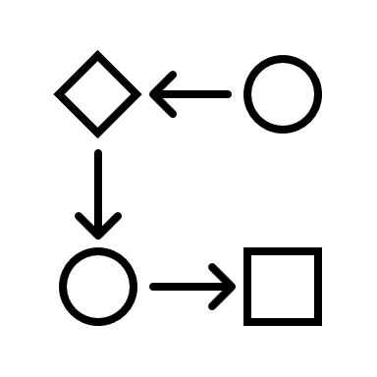

Choices and Steps
Need to select:
Reference population
Foods to include in the basket
Total number of calories per capita or per AME
Steps
Calculate quantity of each food in the basket
Cost each food in the basket using $p_{0}$
OR construct cost-per-calorie and multiply

Slide 58

Reference Population
Composition of the basket should reflect the actual food consumption patterns of “poor” people
The reference population defines exactly what we mean by poor
Usually defined in terms of deciles (either of food consumption or total consumption), should exclude top and bottom deciles

Slide 59
Foods to Include
Including every single food item from a survey (if there are hundreds) can be more trouble than it is worth.
Requires converting non-standard units to grams for every item
Requires finding calorie per 100 g values for every food item
Composite items (prepared meals) can be very heterogenous and thus difficult to construct meaningful prices / calorie values
Results in a huge basket that contains tiny amounts of rarely consumed foods
Want to include a reasonable number of items that account for most of the food consumption of the poor across the country
Often use target like foods that account for 80% or 90% of the total value of food consumption

Slide 60
Foods to Include – Prepared/Composite Foods
Some countries include prepared meals, some do not
Need to calculate cost per calorie
Can assume it is the same as the average for other items in the basket. Reasonable in cases where prepared meals are very similar to meals cooked at home and overheads / profit margins are very low
Can assume it is a multiple of the average of other items in the basket, usually in the range of 1.1 times to 1.5 times. Allows for additional costs of preparing and serving food, profit margins
Some countries do studies of restaurants, looking at nutritional content of food and the cost

Slide 61
Calorie Requirement
Depends on choice of equivalence scale
If using calorie-based scale, use calories for adult male
If using per capita, apply population structure to calorie needs
These are average calorie needs, significantly higher than “minimum” calorie needs FAO uses to get country-level minimum calorie requirements
age | coeff | calories | % of pop | for per cap
0 to 1 | 0.25 | 675 | 2.42 | 16.335
1 to 3 | 0.45 | 1215 | 8.87 | 107.771
4 to 6 | 0.62 | 1674 | 9.36 | 156.686
7 to 10 | 0.69 | 1863 | 12.10 | 225.423
11 to 14 M | 0.86 | 2322 | 5.01 | 116.332
11 to 14 F | 0.76 | 2052 | 4.49 | 92.135
15 to 18 M | 1.03 | 2781 | 4.16 | 115.690
15 to 18 F | 0.76 | 2052 | 4.40 | 90.288
19 to 50 M | 1 | 2700 | 17.41 | 470.070
19 to 50 F | 0.76 | 2052 | 21.11 | 433.177
51+ M | 0.79 | 2133 | 5.10 | 108.783
51+ F | 0.66 | 1782 | 5.58 | 99.436
 |  |  |  | 2032.125
If using calorie-based
If using per capita

Slide 62
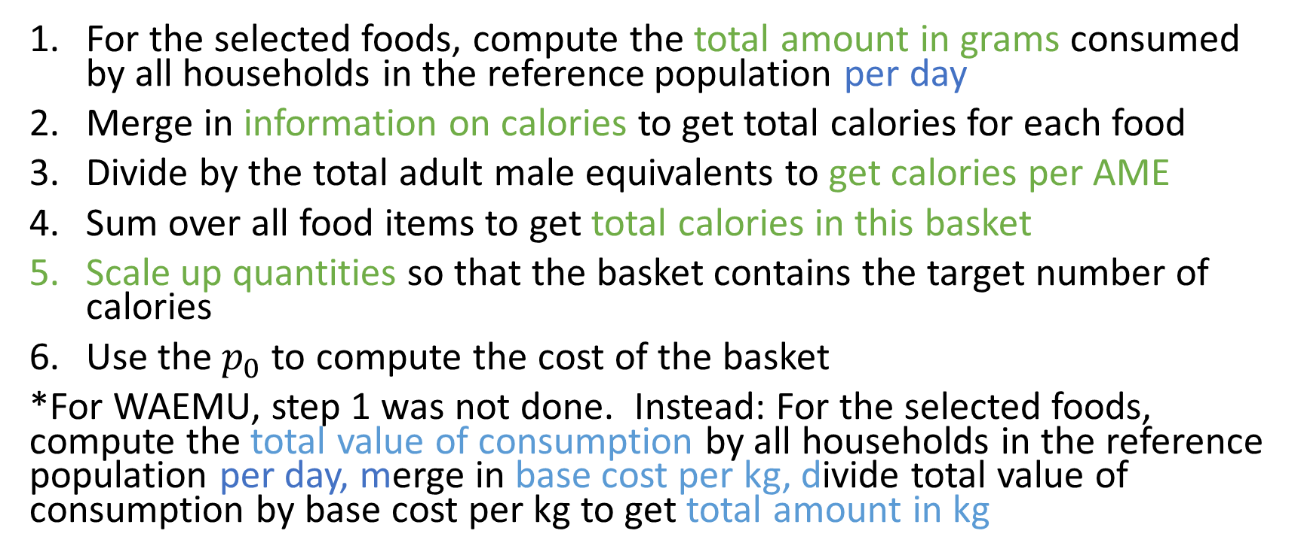
Quantities for Basket - Explicit
For the selected foods, compute the total amount in grams consumed by all households in the reference population per day
Merge in information on calories to get total calories for each food
Divide by the total adult male equivalents to get calories per AME
Sum over all food items to get total calories in this basket
Scale up quantities so that the basket contains the target number of calories
Use the $p_{0}$to compute the cost of the basket
*For WAEMU, step 1 was not done. Instead: For the selected foods, compute the total value of consumption by all households in the reference population per day, merge in base cost per kg, divide total value of consumption by base cost per kg to get total amount in kg

Slide 63
Cost-per-Calorie Approach
Cost per calorie method – two variations
Plutocratic: calculate (weighted) total calories consumed by reference population and total (weighted) value of food consumed (using only selected items to avoid having to calculate calories for hundreds of food items)
Democratic: compute cost per calorie (using only selected items) for each household in the reference population, then calculate (weighted) average
Scale up to cost for target number of calories
Computationally the easiest
Plutocratic should be equivalent to explicit basket
Don’t get actual basket quantities which can be a useful check

Slide 64
Evaluating the Basket
In every context I know of, the basket is picked just to provide a certain number of calories
Can easily use food composition tables to see how much protein, vitamin A etc the basket provides, and if this meets nutritional standards
With slightly more work could construct a basket that meets multiple minimum requirements, in terms of calories, protein etc

Slide 65
Nonfood Component
Ravallion methodology

Slide 66
Ravallion (1998)
Proposed an upper and lower bound on the nonfood component, based on how households actually balance food and nonfood needs
Assumes hierarchy of needs:
Survival food needs
Basic non-food needs
Basic food needs
Food Poverty Line is (1) + (3). Want to determine appropriate value for (2)

Slide 67
Upper Bounds vs Lower Bounds
Consider someone whose food spending equals the food poverty line (1)+(3).
This person must have already met all their basic nonfood needs, so their nonfood expenditure must be greater than (2).
Consider someone whose total spending equals the food poverty line (1)+(3).
This person has sacrificed basic food needs to purchase basic nonfood needs, so their nonfood expenditure must be less than (2).

Slide 68
Estimating
Ravallion recommends a nonparametric method to estimate.
For upper bound: for values of x from 1 to 10
Calculate average total nonfood consumption per AME [capita] for households whose food consumption is within x% of the food poverty line
Take the average of these 10 averages, this is the nonfood component
Some countries use a simpler approach and just take the average nonfood expenditure for households whose food consumption is within 10% of the food poverty line.
For lower bound, replace food consumption with total consumption.

Slide 69
Construction
Poverty line is cost of basket + nonfood component calculated via Ravallion
Expressed per capita or AME in overall national prices
The welfare aggregate is also in these terms, this is usually how we do the calculations of poverty, equality etc
For some purposes, it may be helpful to express the poverty line in terms of total needs for a family of 5 (say) in the prices in different parts of the country.

Slide 70
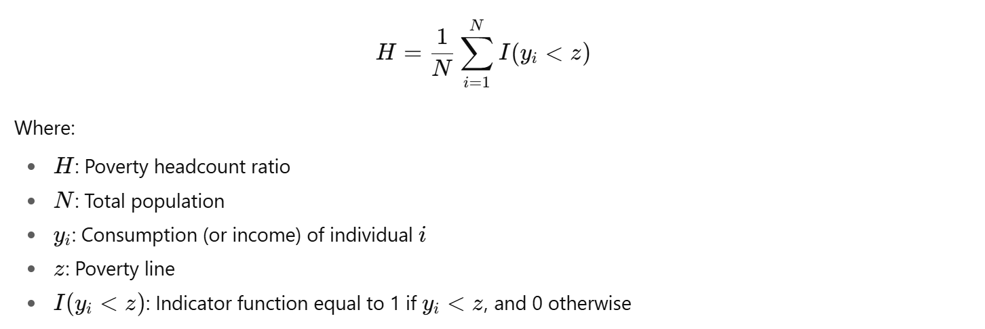
Poverty rate
A poverty rate can be computed by comparing per capita consumption to the poverty line and calculating the percentage of the population living below it.

